Slide 1
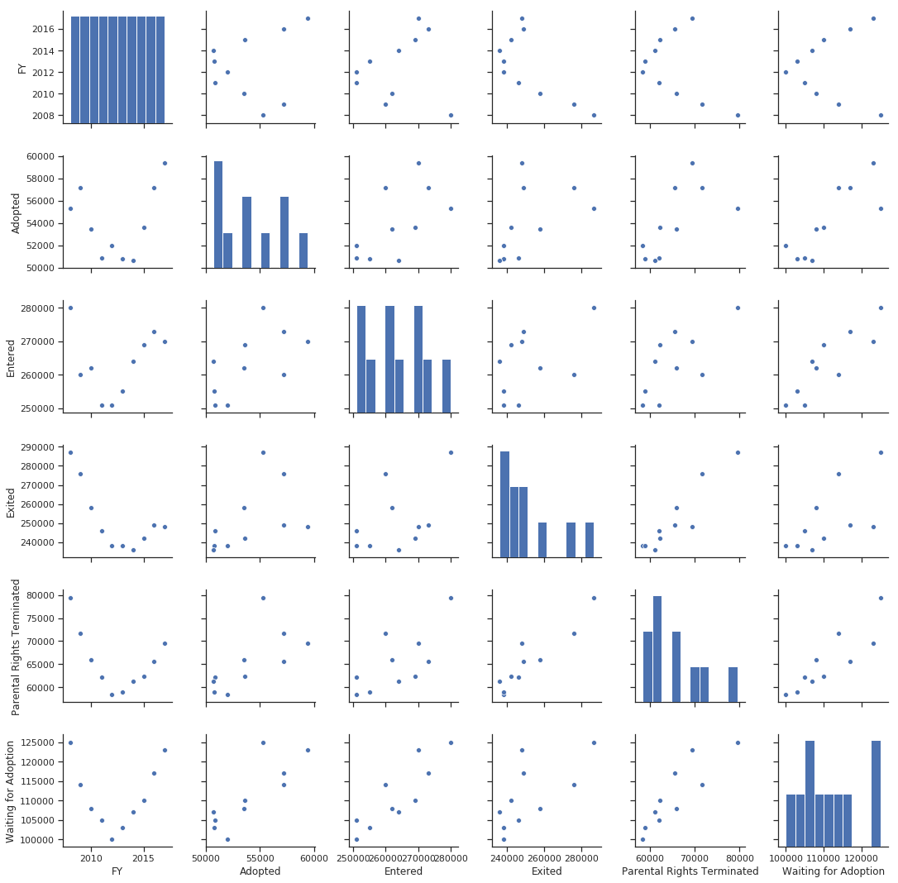
Trends in Foster Care 2008 - 2017
(Or the lack thereof…)

Slide 2
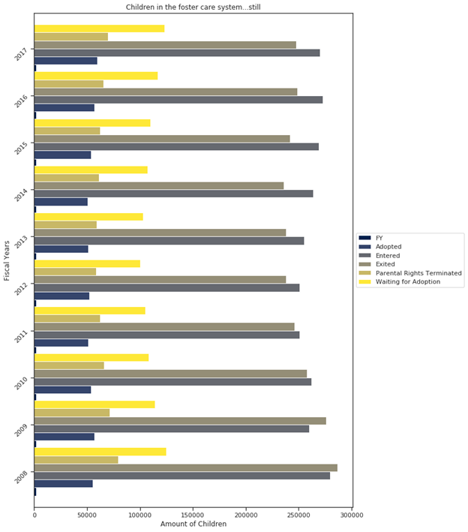
A broken system cannot be fixed by following the same processes. Any change would reduce the standardization of the data. Let's look at the data from 2008 to 2017.
The data changes gradually but is almost right back to where we started. Why? Because either nothing has changed or nothing that changed was kept in process.

Slide 3

Many do not see these children for what they are, orphans. They've lost their parent(s) to addiction, jail, or death. These children have no permanent home.
Some spend their entire childhood being bounced from family member to foster home, foster homes to group homes, and group homes to residential treatment facilities. Eventually, they all "age out" of the system. The state is no longer obligated to care for them. Unfortunately, by the time they have “aged out” of the system, many have been institutionalized and lack many basic social skills.

Slide 4

There are very few programs to assist young adults who are alone in the world the moment they reach legal adulthood. Some will return home to the dysfunctional family they were removed from in the first place.
Typically this does not end well.

Slide 5
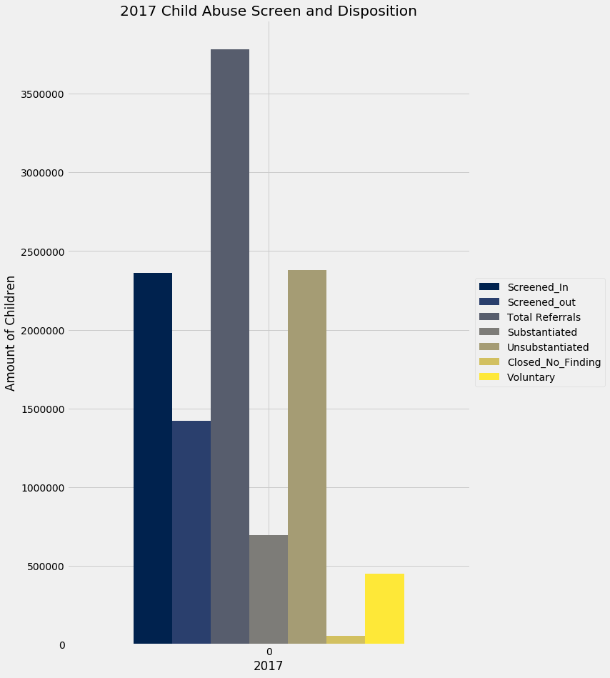
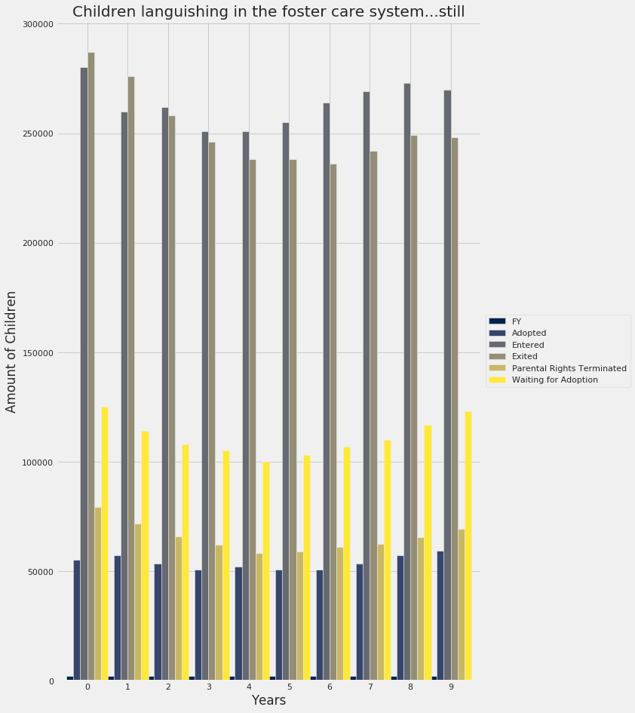

The graph on the left are referral calls that were made to a hotline and the result of these referrals. When you compare the information, the similarities of substantiated findings of neglect and abuse, and children waiting to be adopted are obvious.
2017
The Voluntary cases are children who voluntarily signed away the rights to their children.

Slide 6
Trends in Foster Care 2008 - 2017
Source: https://www.acf.hhs.gov/cb/resource/trends-in-foster-care-and-adoption
You can explore the data sets and my blog at the links below:
https://github.com/KryssyCo/DS-Unit-1-Sprint-5-Data-Storytelling-Blog-Post/blob/master/
national_afcars_trends_08thru17.updated2.csv
https://github.com/KryssyCo/DS-Unit-1-Sprint-5-Data-Storytelling-Blog-Post/blob/master/
Krista_Shepard_DS5_Final_Notebook_Children_in_Foster_Care.ipynb
https://github.com/KryssyCo/DS-Unit-1-Sprint-5-Data-Storytelling-Blog-Post/blob/master/
SISO%20National.csv
https://github.com/KryssyCo/DS-Unit-1-Sprint-5-Data-Storytelling-Blog-Post/blob/master/
Child_Abuse_Data_Sets.ipynb
kryssyco@github.io
https://medium.com/@kjshepard70/my-first-project-f649d36716f5?postPublishedType=initial
(Or the lack thereof…)

